Slide 1
EzJob
Helping Candidates in every step of the Job Process!
Group 6:
Andrew Currie Naga Sri Pravallika Golla Kethan Makkini Venkatesh Vindhya Rayabharapu Deva Harsha Nuthakki Bhuvanchand Singu

Slide 2
Introduction

Slide 3



Problem Statement
Job applicants contend with uncertainty regarding their application status due to limited real-time communication, resulting in prolonged waiting periods and heightened anxiety. Simultaneously, HR professionals face challenges in delivering timely feedback.

Slide 4

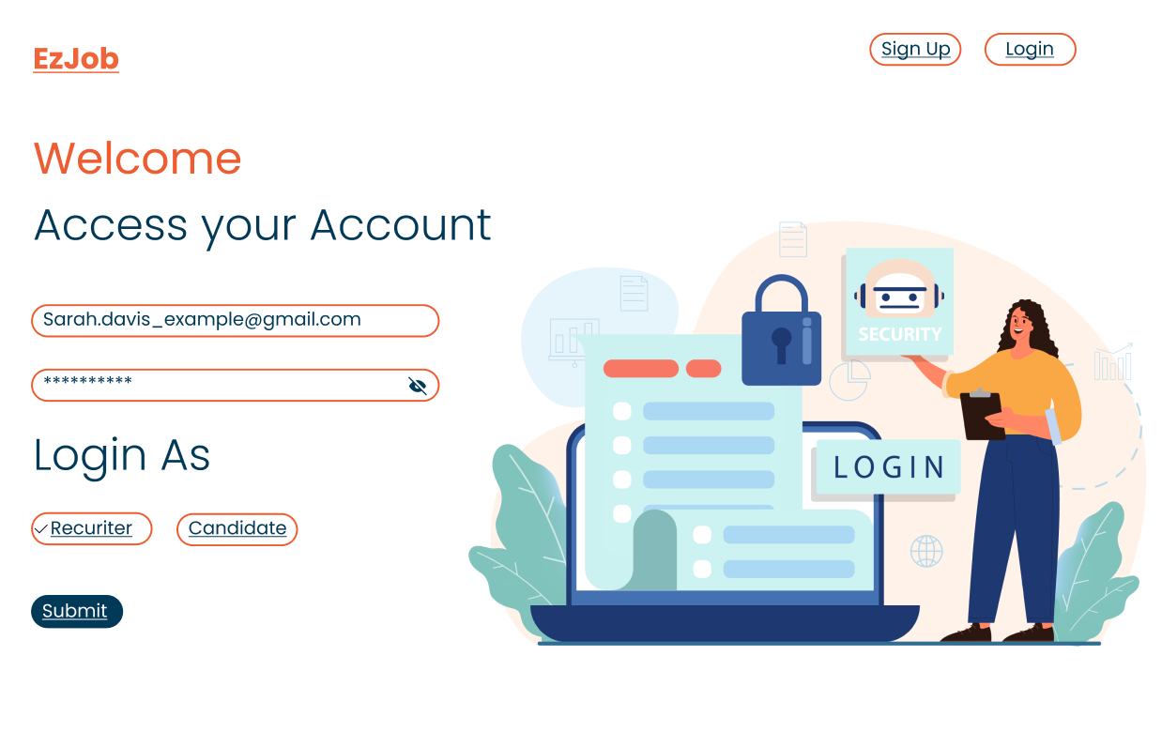
EzJob
An application facilitating recruiters to post real-time updates, while providing candidates with the ability to check the latest updates for their job applications in real-time.

Slide 5
Research

Slide 6
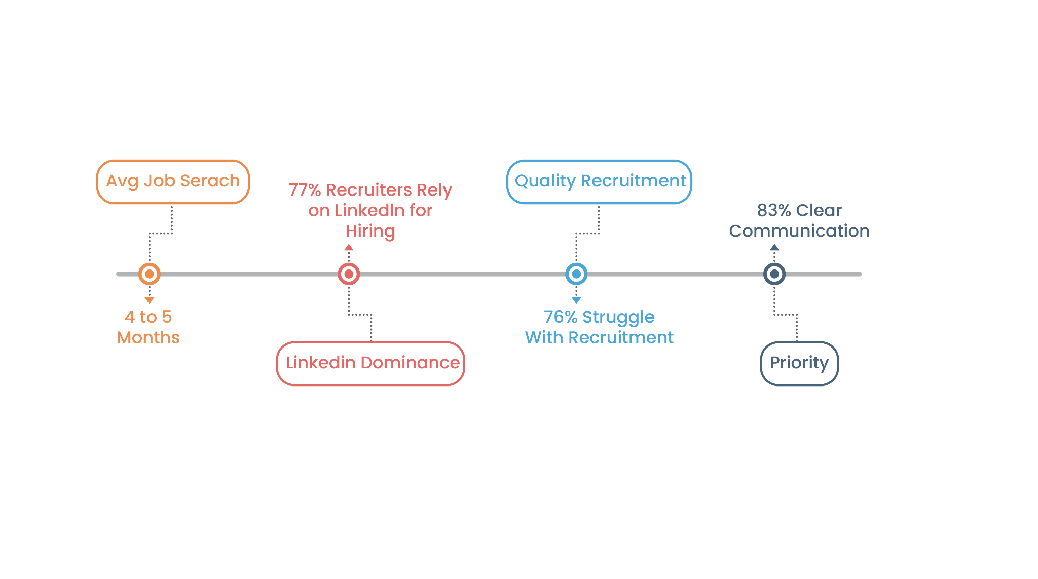
Initial Research

Slide 7
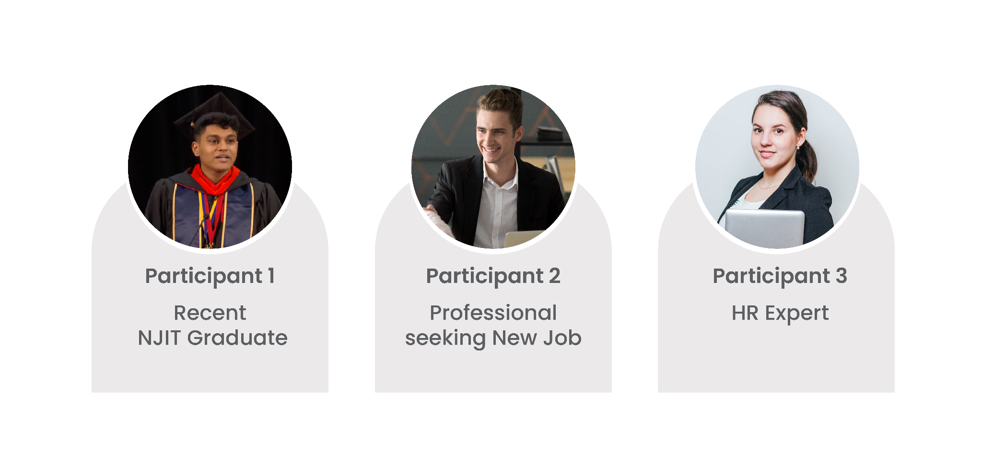
Interviews

Slide 8
Survey
A 12 question online survey with open ended and multiple choice questions was sent out to people.
Results indicated that candidates felt it takes too long to hear back from recruiters.
Recruiters lose quality applications due to inefficient information flow and long wait times.
Candidates found better success at job fairs or through connections
https://docs.google.com/forms/d/10SVPwYedlGyYZRKrr2RiTEfJfq9zlBVCiZAcpp45NAQ/edit?pli=1

Slide 9
Design

Slide 10
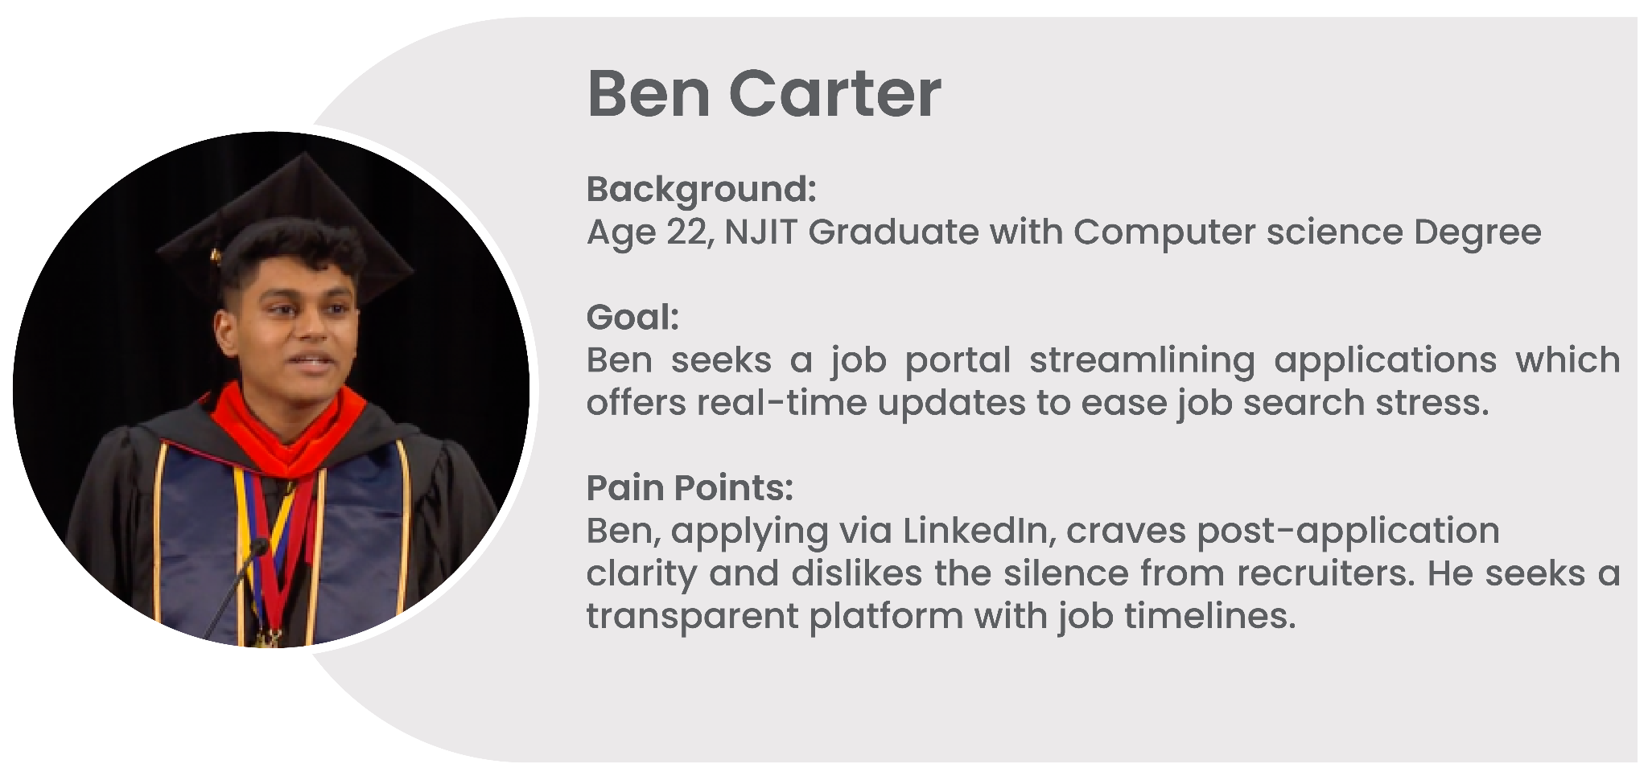
Persona 1

Slide 11
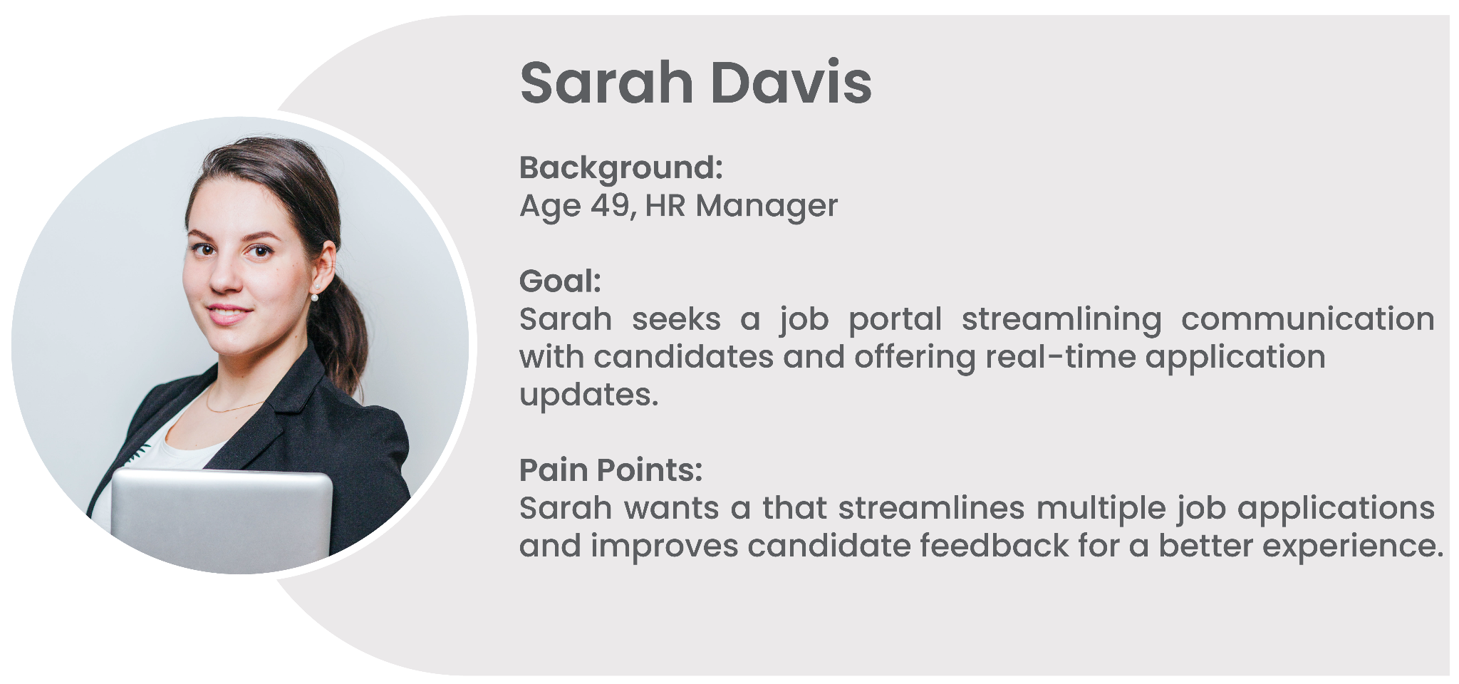
Persona 2

Slide 12
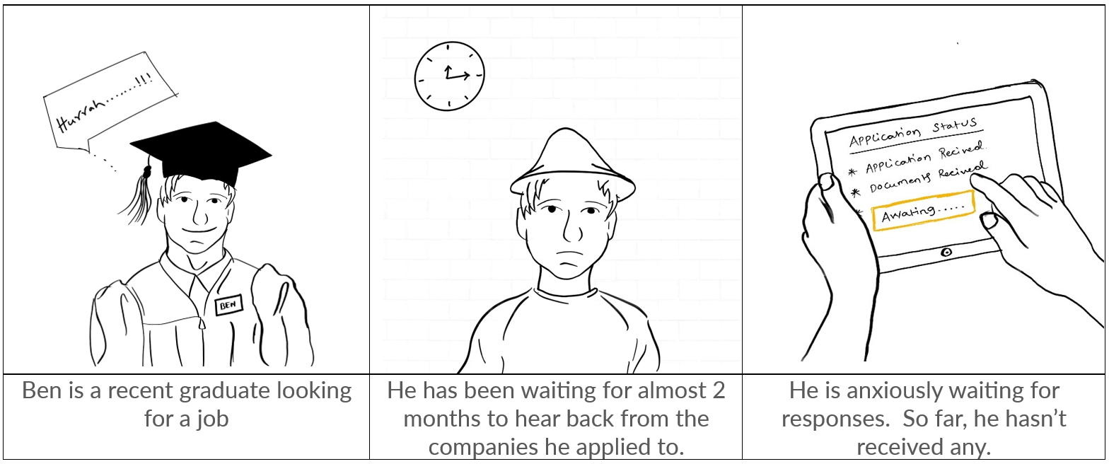
Storyboard

Slide 13
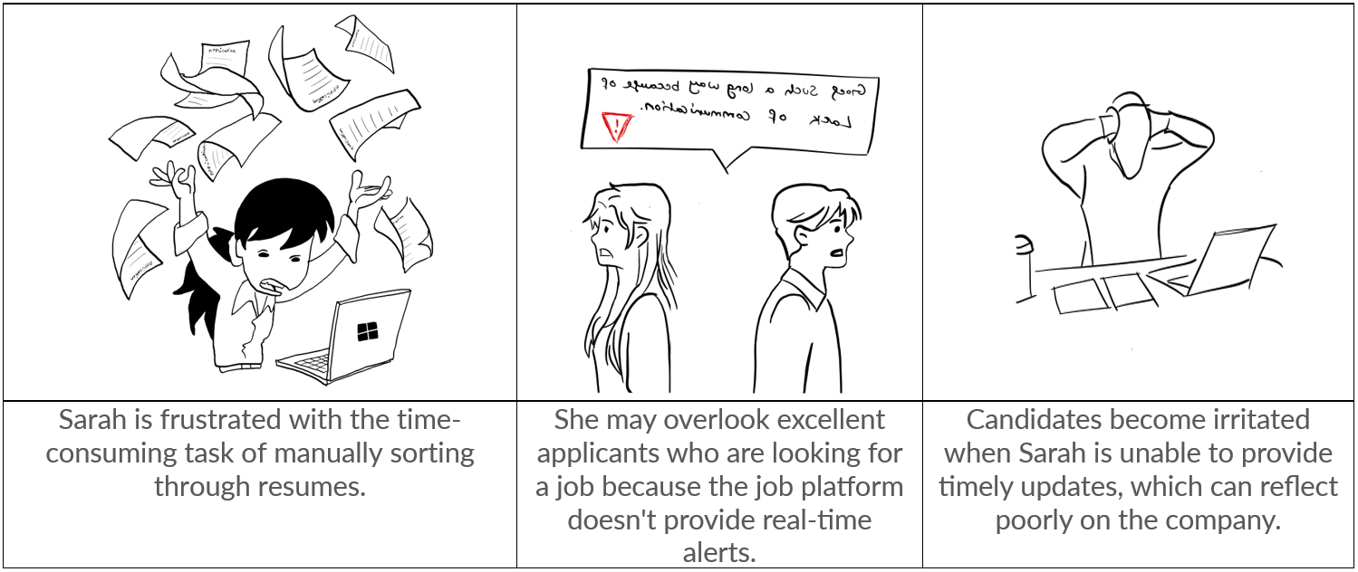
Storyboard

Slide 14
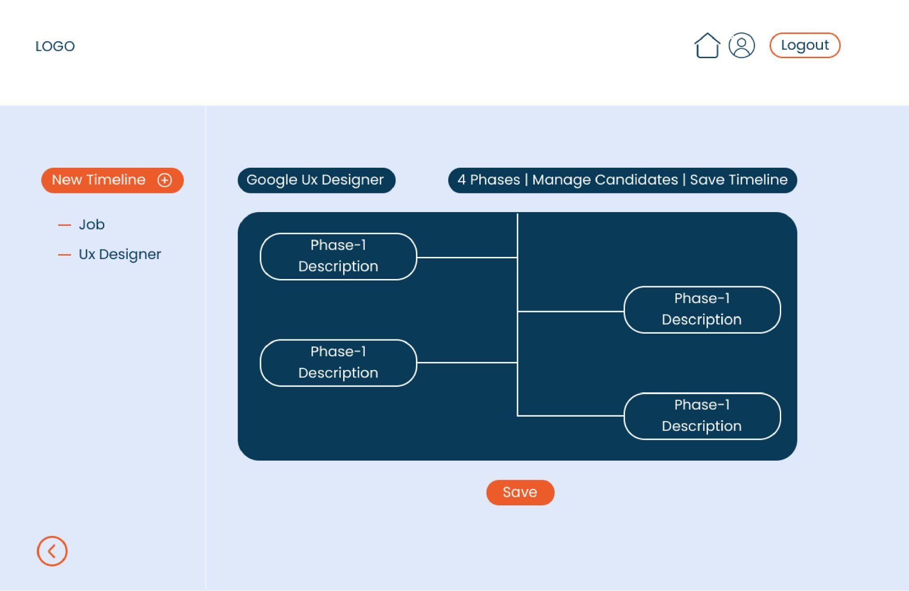
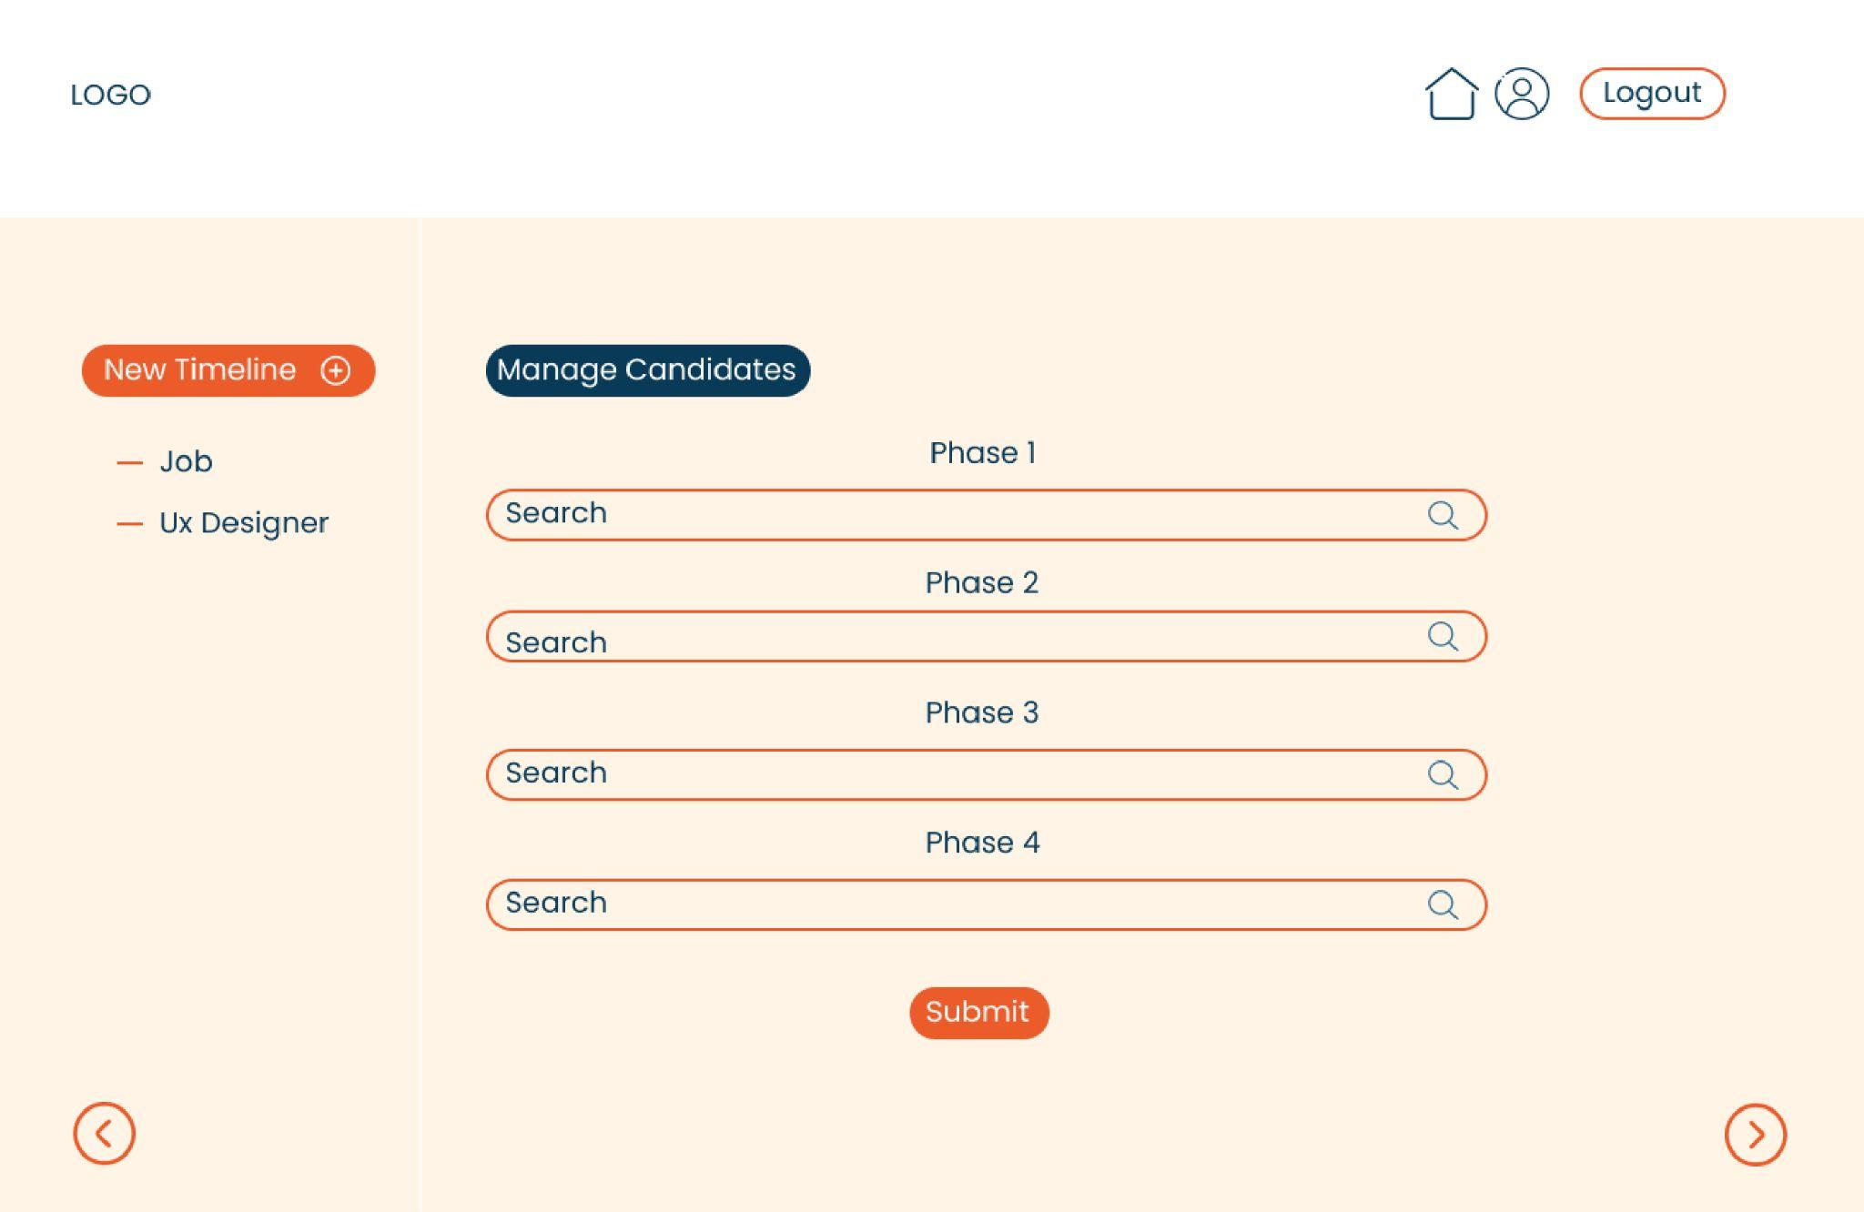
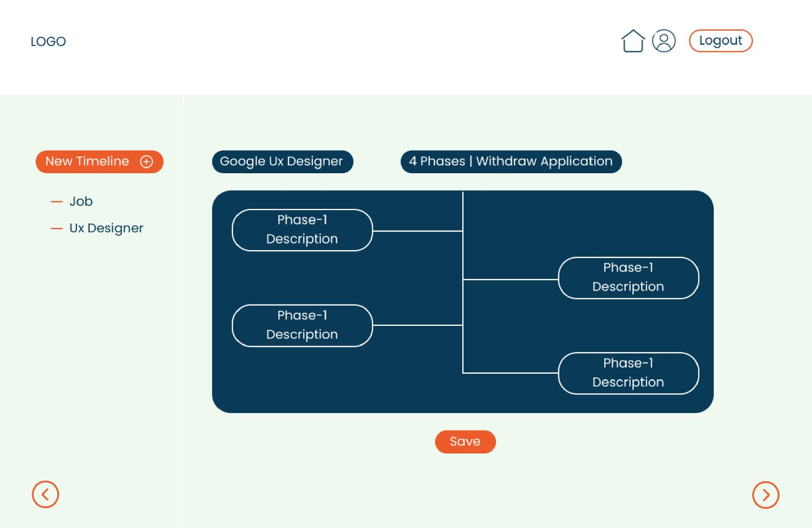
Wireframes
We created a prototype using Figma, giving us a detailed visual map of how everything works.
https://www.figma.com/file/xoYvqcbOOMo2xYqgW0CeC3/UX-Project-(Copy)?type=design&node-id=0-1&mode=design&t=UKQwox6PsSNoGDdx-0

Slide 15
User Testing

Slide 16
Tasks
We created three tasks to test with our users as part of User Testing.
Task 1: Go to the EzJob site and post a new job opening.
Task 2: You want to check the status of a resume that you recently submitted to a company.
Task 3: You want to invite candidates to a job posting and add/remove them across different phases in the job process.

Slide 17
Feedback
We reached out to 2 Job Seekers and 1 HR professionals to test our website.
Tester’s identified certain ambiguities in the job portal's phases page.
The recruiter told that EzJob would be a great integration to his recruitment portal.
Job Seeker (Participant 1) mentioned that he would use EzJob for real-time updates on recruitment, timings, and the interview progress.
Job Seeker (Participant 2) specified that feedback from the recruiters would be a great addition to the website.

Slide 18
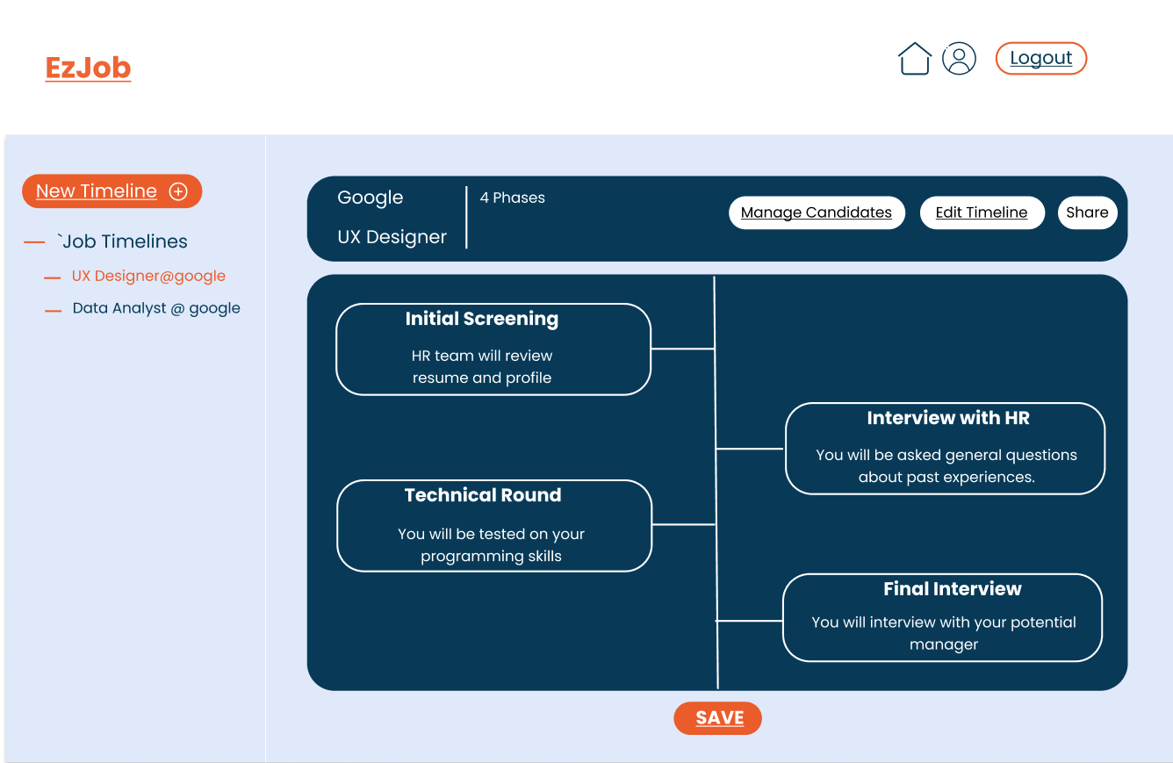
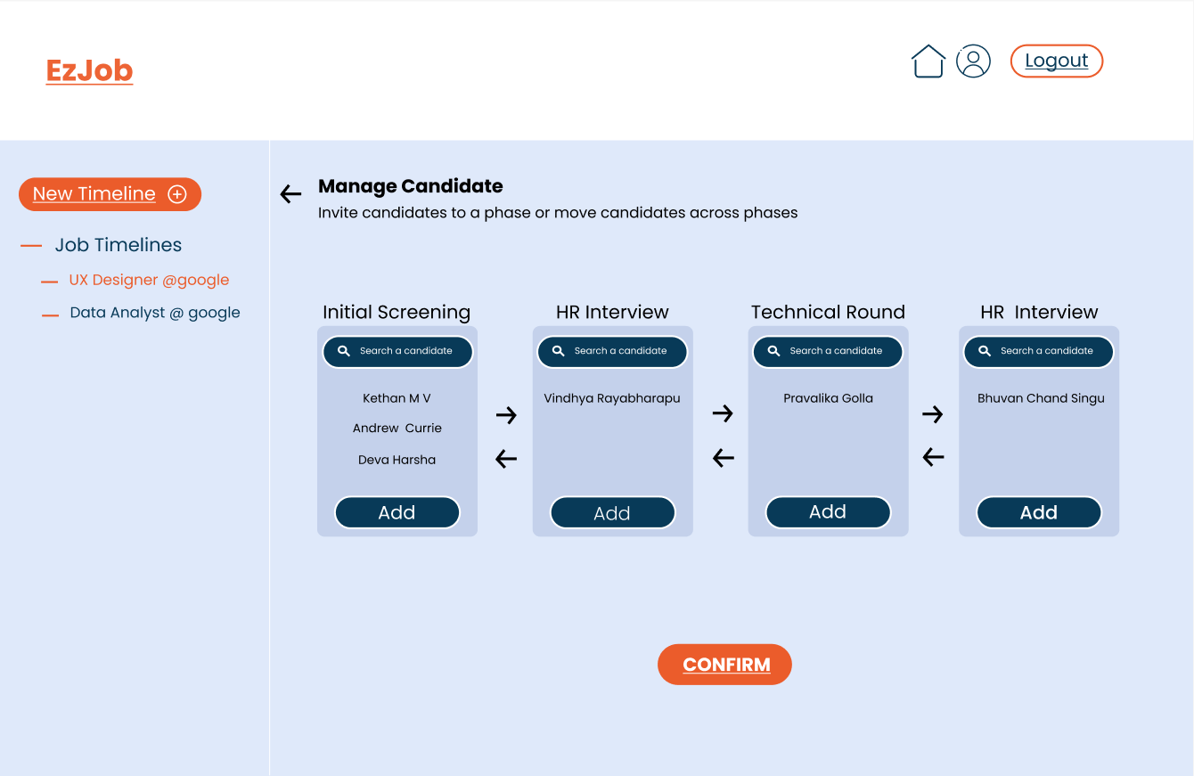
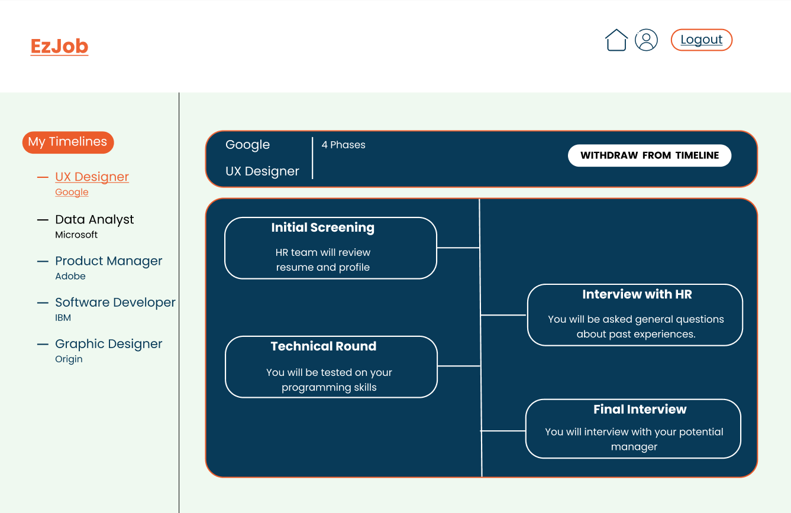
Revisions
After gathering insights from user testing, we revamped certain pages in our app to enhance the user experience.

Slide 19
Final Prototype
https://www.figma.com/proto/wi8j2M6BJmlILy9hVrAl8a/UX-Project?type=design&node-id=1-3&t=EkLR8i7NtN5z73ok-1&scaling=min-zoom&page-id=72%3A314&mode=design

Slide 20
Reflections
We were able to solve the underlying problem related to job applications.
Our main challenge was to prioritize the features we brainstormed during the planning phase.
Through User Testing, we identified some issues with our design.
A key suggestion we received is to integrate feedback mechanism into the website.
Potential improvements to include in the future:
Feedback from recruiters
Adding templates for timelines to minimize the creation of it
Adding new phase button

Slide 21
Conclusion
We were able to identify a common problem faced by many in the job application process.
We validated this problem by conducting research, surveys, interviewing hiring managers and candidates.
Understood the problem from user perspective by creating personas, scenarios, storyboards and user journey map.
Landed on a design solution by creating sitemap, screen flows and wireframes.
Made revisions to the design by conducting usability tests with our users.

Slide 22
Thank You.

